Slide 1



Rail Baltica
project status and CCS deployment
22nd August till 25th August 2022
CCS Market Consultations
RB Rail / CCS Engineer

Slide 2
Agenda
Brief introduction to the Rail Baltica project and project schedule.
Supplier's presentation : Support to Rail Baltica in reaching the targets
  Single design concept across 3 Baltic states resulting in scale and maintenance economies, limited number of interfaces
  Implementation of ETCS Baseline 4 Release 1; RMR Baseline 1; ATO Baseline 1
  Interfaces according to EULYNX Specifications
  Traffic Management System TD 2.9
  No trackside signals on secondary tracks and shunting areas
  No copper cables on open line
  Usage of local renewable power supply sources for CCS equipment
Q&A session

Slide 3

Basis for new economic corridor, post-Covid recovery and military mobility
Helsinki
870 km greenfield railway infrastructure
Muuga
Tallinn
0:40 min
1435 mm
Double track
Pärnu
Pärnu
1 h
Rīga Central
ERTMS Level 2 + FRMCS
0:08 min
Salaspils
Rīga Airport
Electrified
2x25kV AC
0:45 min
Panevėžys
Panevėžys
Vilnius
Maximum length of freight trains: 1050m
0:37 min
Vilnius
Kaunas
Kaunas
3:27 min
Axle load 25t
Warszawa
0:38 min
Hamburg
Warszawa
Design speed:
249 km/h for passenger trains
120 km/h for freight trains
Berlin
High Speed
Rotterdam
Duisburg
Night Train
SE-C (Swedish) loading gauge
Freight
Antwerpen
Wien
Regional/Halt (38/15)
Milano

Slide 4

Contracting Overview
Contracting Entities
Assets
Contracting Approach
Overhead
catenary system
Long term development and commercialization
  External support contracted directly by RBR
  Direct stakeholder engagement
JV RB Rail
  Signalling System
  Comms and SCADA
  ENE
Rail Systems
  Design and build contracts
  Based on FIDIC Yellow book
  Centralised component sourcing
Communications
Rolling stock**
Signalling
Trackwork
  Embankments
  Bridges
  Viaducts
  Track
LTGI
Alignment
  Construct only contracts
  Based on FIDIC Red Book
  Mutliple packages
Civil works
EDzl
RB Estonia
Fixed
objects
  Mix of contract types
  Based on FIDIC Red and Yellow Books
  Stations
  Depots
  Freight facilities
RB Rail *
* RB Rail AS is responsible for cross border elements of alignment
** Rolling stock procurement is not part of the current project scope

Slide 5
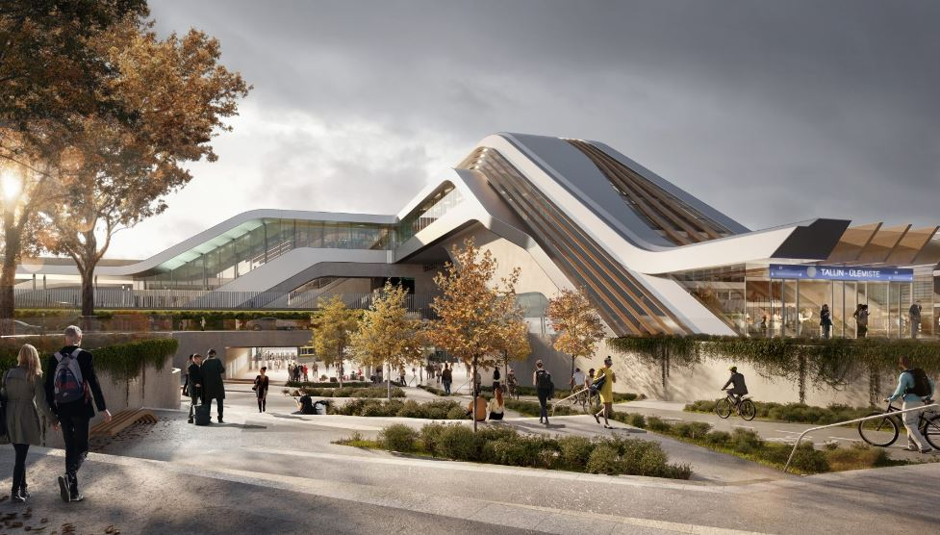
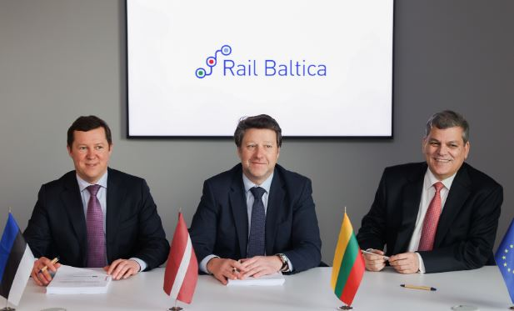
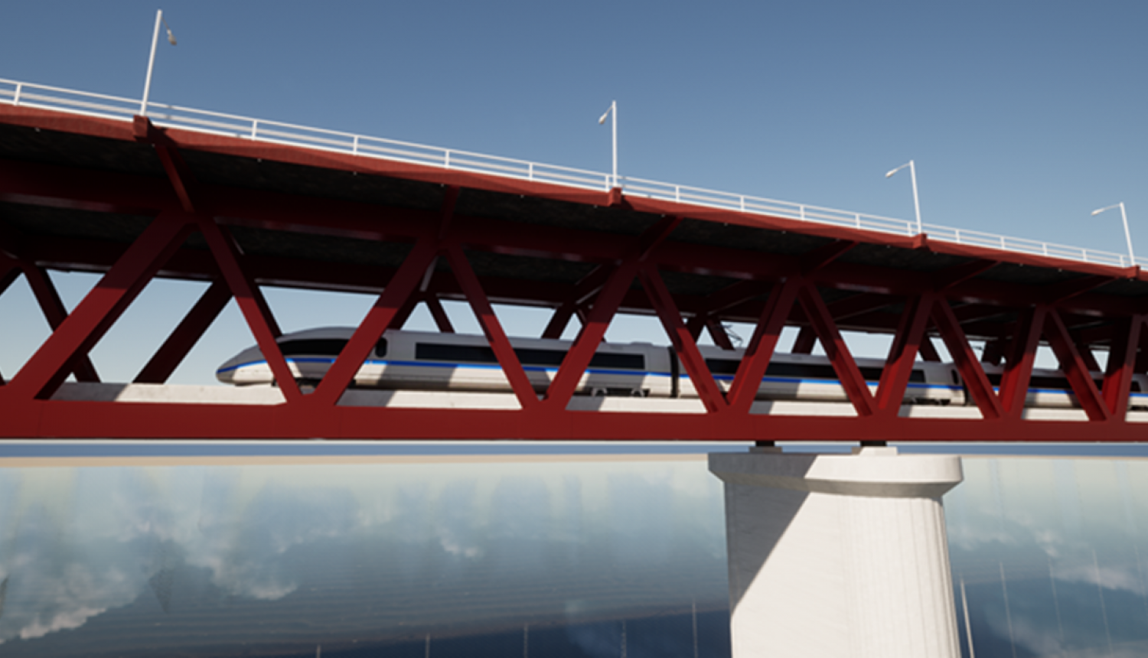
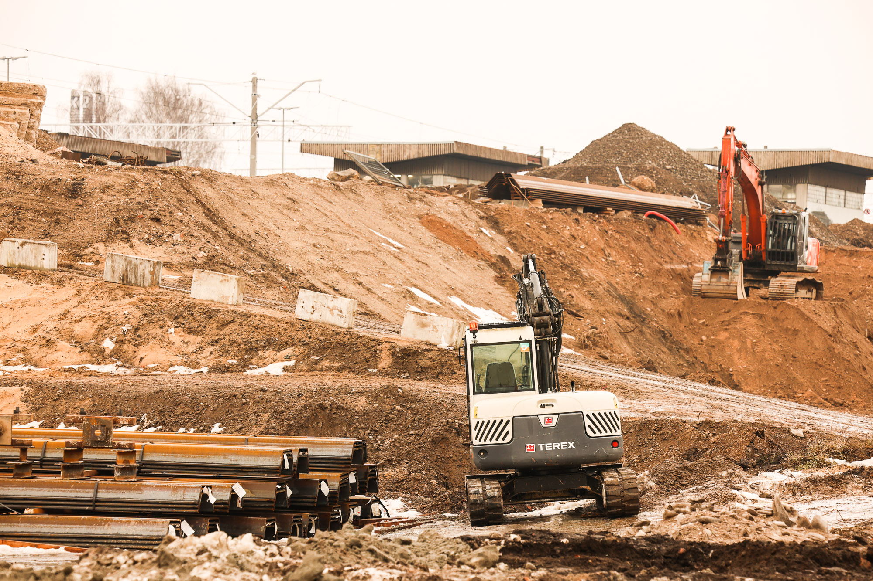
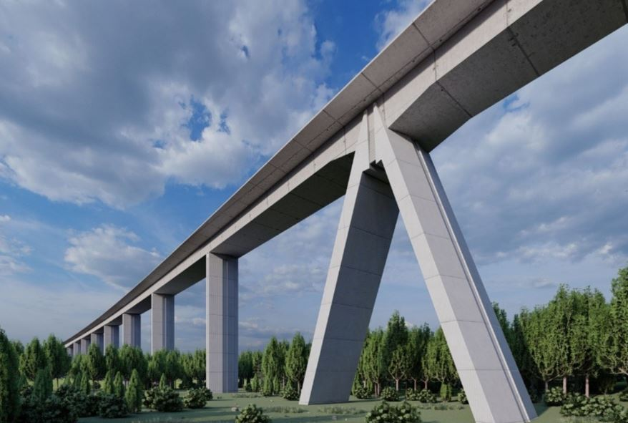
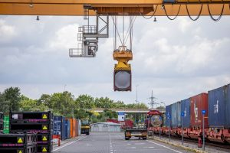
Rail Baltica project progress – status 2022
Civil Design works in advanced stage on more than 640km
First phase of construction works ongoing in all countries
Electrification deployment strategy selected and Electrification Design and build procurement launched
Control-Command and Signalling Engineer selected, work on deployment strategy started
Consolidated construction material procurements reaching 2nd phase
More than 150 active contracts with total est. value above 900 MEUR. Over 200 Baltic and 50 international partnerships
First activities applied for under Military Mobility (LV, LT) supported, next ones being prepared
Procurement plan 2022 with total contract value exceeding EUR 2 billion published
Finland and Poland – full commitment and enhanced cooperation

Slide 6
Rail Baltica project timeline
Large scale main line design ongoing
Initial construction activities started in 3 Baltic states
Preparations for railway systems procurements
First consolidated procurements for construction materials launched
Acknowledging the new economic corridor potential
100 % mainline construction readiness & large-scale construction works advancing
Railway systems full scale implementation
Point type objects advancing
Stimulus to the economy
Progressive completion and start of operations of Rail Baltica
Full interoperability ensured
New economic corridor kick-started
A well-functioning market for services and investment emerges
2021-2022
2024
2026 - 2030
Gradual start of construction
Phased start of operations

Slide 7

Procurement
Notes:
Jake

Slide 8
What suppliers should be aware of?
RB Rail AS contracts are awarded by procuring in accordance with Public Procurement Law of Republic of Latvia.
Submission of bids are managed via an e-procurement system (www.eis.gov.lv); register your company and get acquainted to the tool
  Owned & operated by state authorities
  Manual is available on www.railbaltica.org
Follow the development of the project via our webpage: www.railbaltica.org
Sign up to the newsletter and procurement news

Slide 9




How to get involved with a Rail Baltica procurement
Main tips
E-tendering - Supplier has to register in e-procurement system
Please make sure you submit your tender once uploaded
All procurement related information as well as how to register is available on Railbaltica.org website
Carefully manage deadlines
Careful attention to tender requirements
Please provide questions & feedback as early as possible on any tender documents and/or extensions
E-procurement
Supplier declaration
To be signed by winner
Newsletters + promotion
(subscription advised), Website, TED*
Procurement Policy
Available on the project website under the Procurement tab
* Tender Electronic Daily

Slide 10
CCS D&B procurement
Current status:
  CCS Engineer in place since January 2022, preparing Concept design, defining deployment strategy.
  CCS deployment strategy finalising and entering into procurement preparation phase.
  Subject matter of the procurement – single CCS Design and build contract (under FIDIC Yellow book).
Potential public procurement procedure – two stage procedure «Competitive procedure with negotiations» which consists of 2 stages:
  Qualification stage in final form of tendering (solo or partnership, no change of tenderers afterwards)
  Technical and financial proposal stage + negotiations.
  Procurement schedule:
  Market consultations taking place: 22.08 – 25.08.2022.
  Announcement of the first stage (pre-qualification) of the procurement: Q4 2022.
  Tender/Proposal submission: Q2/Q3-2023.
  Contract signing: end 2023.

Slide 11
Rail Baltica CCS Deployment
Notes:
Jake

Slide 12
870 km of main line double track
7 international stations
23 regional stops/15 halts
CCS Subsystems Breakdown Structure
Single design concept across 3 Baltic states resulting in scale and maintenance economies, limited number of interfaces
TSI CCS
Systems
Interface to civil works
Sustainability and Life-Cycle Cost requirements
ERTMS
Inter-
locking
Traffic Mngmt
ICT Systems
Ancillary Systems
Station Systems
Non traction power supply
Cableway System
System
Integration
“State-of-the-art and further” by early adopting the latest evolutions of CCS standardization and initiatives (game changers from Shift2Rail and industry innovations (ATO functionalities, etc.)
ETCS
Axle counters
CTC on main line
Local Operation
Transmission network
Rolling Stock Health Mgmnt
Passenger Information
M/V catenary network connections
Indoor
Radio Block Centre
Passenger Address
Outdoor
Optical Signal
Automatic Route Setting
Voice Comm
Conditions monitoring integration (infra, meteo …)
Technical Buildings
Advanced coordination functions for intermodal operation with 1520 mm railways
Key Mgmnt
Railway Apps
CCTV
LV network connections
Derailer (TBC)
Automatic Train Operation
Master Clock
Balise
Cyber Security
Road Vehicle Detection
Access control
Concentration of equipment in Systems Equipment Locations (around block posts)
On-board Integration
EULYNX
Interface turnout
Ticketing (TBC)
UPS System
Maintenance work Possession Mgmnt
Fire protection
Platform gates
Turnout/track systems PS
Zero copper cables on open line
Intrusion detection
FMRCS
Interfaces to other subsystems (track elements, 1520 Info systems...)
Usage of local renewable power supply
SCADA
Architectural design

Slide 13
Rail Baltica CCS deployment timeline
RB Rail AS
CCS Strategy development
CCS Eng Serv. procurement
CCS Engineer scope of service
Project Management Organisation
FIDIC Supervision
Radio planning
CCS Works Contractor
Deployment
strategy
Application Design
Assistance to procurement
Generic Design*
Construction
Concept design
Works procurement
* Approval
by RB Rail AS
Commissioning
Pre-qualification start : Q2 2022
Proposal submission: Q2/Q3 2023
Contract signing: End 2023
Defect Notification
Period
2020
2021
2022
2023
2024
2025
2026 - 2032
Preparatory phase
Works implementation phase
Notes:
The same approach will be applied for CCS deployment, it is, construction works will be implemented in sections depending of finalisation of civil works and ENE works, therefore in the works implementation phase activities will take place in paralel – the activity will start with first section and end with last section.

Slide 14
Rail Baltica CCS deployment financial planning
Planned financing sources:
  ERTMS unit call for financing of ETCS and associated infrastructure, Class A radio, Interlocking;
  CEF Transport calls for financing of non ERTMS activities (Telecom, Power supply, Station equipment);
  Military mobility funding for financing of non ERTMS activities;
  CEF Digital funding for financing of FRMCS, ETCS, ATO, backbone network implementation;
  PPP is not contemplated;
  Required funding from state national budgets is being analyzed
Prior to CCS contract signature funding will be secured.

Slide 15
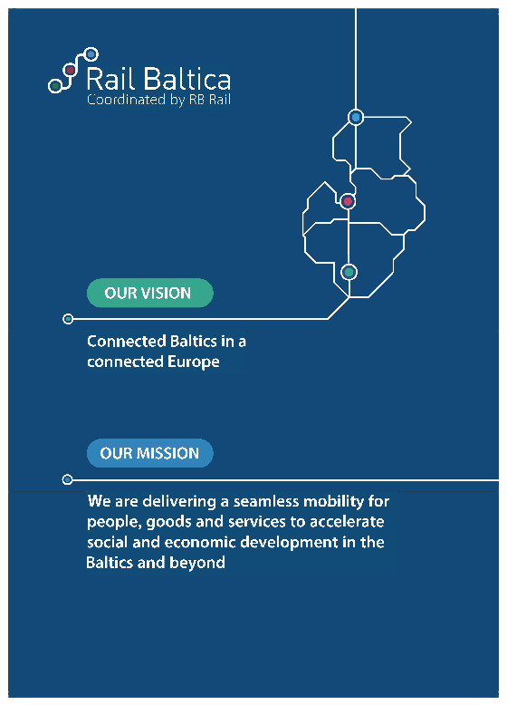



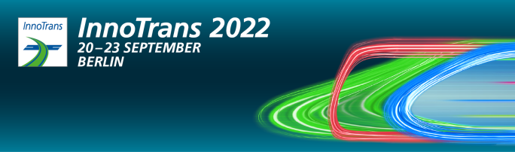
Find us at Hall A , CityCube
Booth #880
Thank You!

