Slide 1


Design and design supervision services for the construction of the new line through Kaunas Urban Node
MARKET CONSULTATION
September, 2022

Slide 2
Agenda
Introduction to the main rules of the meeting (10 min.)
General Introduction to the Rail Baltica Global project (10 min.)
General Information on the planned procurement “Design and design supervision services for the construction of the new line through Kaunas Urban Node” (25 min.)
Q&A session:
RB Rail AS questions to suppliers / suppliers answers (30 min.)
Suppliers questions / RB RAIL AS answers (30 min.)
Other (10 min.)

Slide 3
Rules and purpose of the meeting
Purpose of the consultation: To inform interested suppliers about the planned procurement exercise and the content of the subject-matter, as well as to obtain feedback from the interested suppliers regarding the main requirements.
Legal basis for the consultation: The consultation is organized in accordance with regulation of Section 18(2) of the Public Procurement Law of Latvia, which provides rights for the contracting authority to organize a consultation with suppliers in order to prepare for anticipated procurement procedure and inform potential suppliers about the procurement plan and requirements.
Time and place of the consultation: 30th September 2022 at 13:00 (Riga time), online, using the Microsoft Teams app.
The consultation will be recorded and a summarized version of the minutes will later be made available online at: www.railbaltica.org (a recording in Microsoft Teams will be retained, but not published or shared with the suppliers and/or third parties).
RB RAIL AS shall not disclose any commercially sensitive information provided by suppliers during the meeting.

Slide 4
Rules and purpose of the meeting
Supplier’s confirmation:
By participating in this meeting, the potential Supplier:
Confirms his/her participation in the meeting;
Confirms that the rules of the meeting are clear, and potential Supplier has no objection to the process of meeting.
At the potential Suppliers meeting, RB RAIL AS shall make no promises and/or commitments toward any business agreement or any proposal and shall not provide any acceptance of any offers or potential offers. The potential Suppliers meetings are intended to inform RB RAIL AS on the significant market related conditions. At this meeting, RB RAIL AS is not in a passion to discuss any other topics and shall not provide any information on any ongoing procurement procedures.

Slide 5




Rules and purpose of the meeting
Purpose of the consultation: To inform interested suppliers about the planned procurement exercise and the content of the subject-matter, as well as to obtain feedback from the interested suppliers regarding the main requirements.
Legal basis of the consultation: The consultation is organized in accordance with regulation of Section 18(2) of the Public Procurement Law of Republic of Latvia, with provides rights for the contracting authority to organize a consultation with suppliers in order to prepare for anticipated procurement procedure and inform potential suppliers about the procurement plan and requirements.
Time and place of the consultation: 11th February 2022 at 9:00 (Vilnius time), online, using Microsoft Teams app.
Meeting will be recorded for reference, transparency and audit purposes and summarized version of the minutes of meeting will later be made available online at: https://www.railbaltica.org. Sound/Video recordings of the e-meeting will not be shared with the suppliers and/or third parties.
RB RAIL AS shall not disclose any commercially sensitive information provided by suppliers during or after e-meeting.
Supplier’s confirmation:
By participating in this meeting the potential Supplier:
Confirms his/her participation in the e-meeting;
Confirms that the rules of meeting are clear, and potential Supplier has no objection to the process of meeting.
At the potential Suppliers meeting, RAB RAIL AS shall make no promises and/or commitments towards any busines agreement or any proposal and shall not provide any acceptance of any offers or potential offers. The potential Suppliers meeting are intended to inform RB RAIL AS on the significant market related conditions. At this meeting, RB RAIL AS is not in position to discuss any other topics and shall not provide any information on any ongoing procurement procedures.

Slide 6
















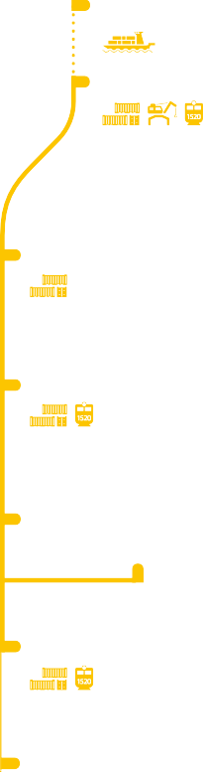








































































Slide 7
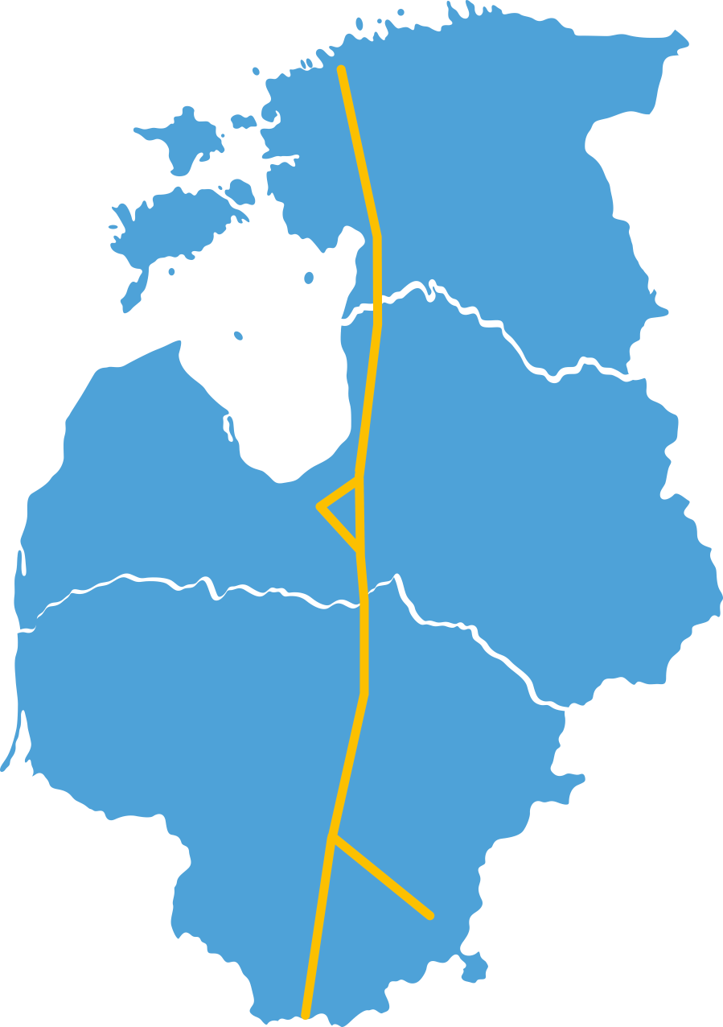







































Progress of the project in 2021-2022
nfrastructure
Vilnius – Kaunas and Jiesia – PL/LT tenders announced

Slide 8

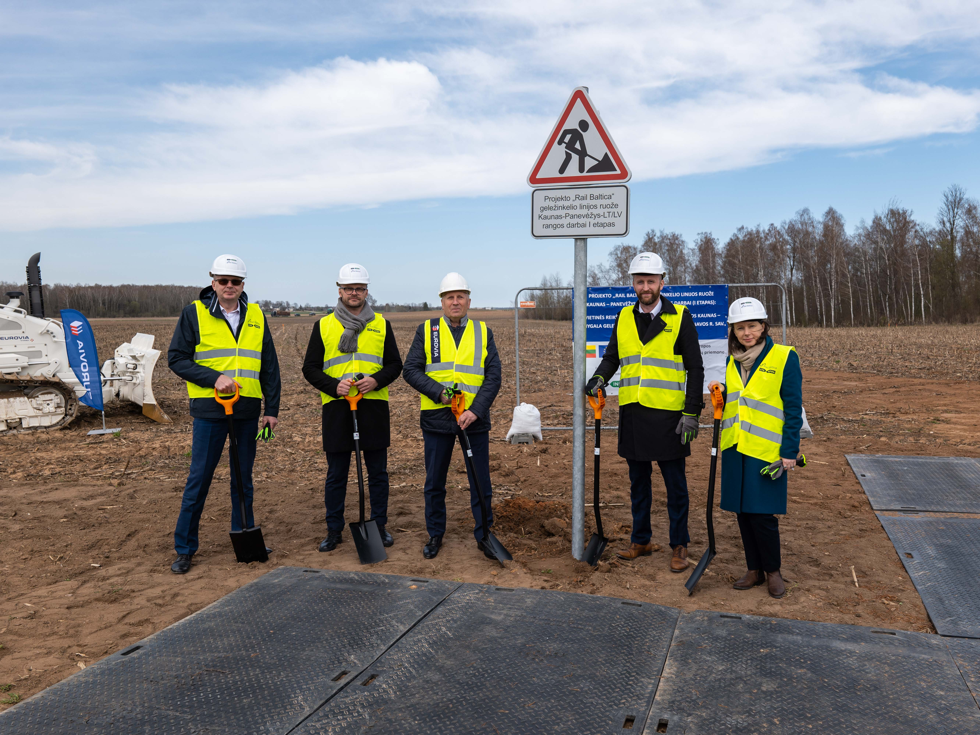

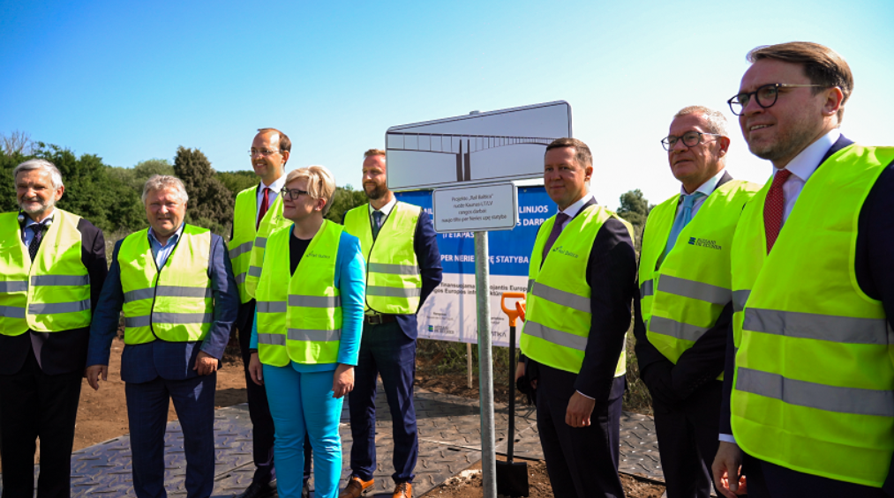
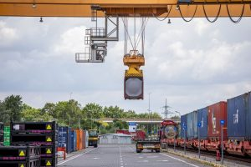
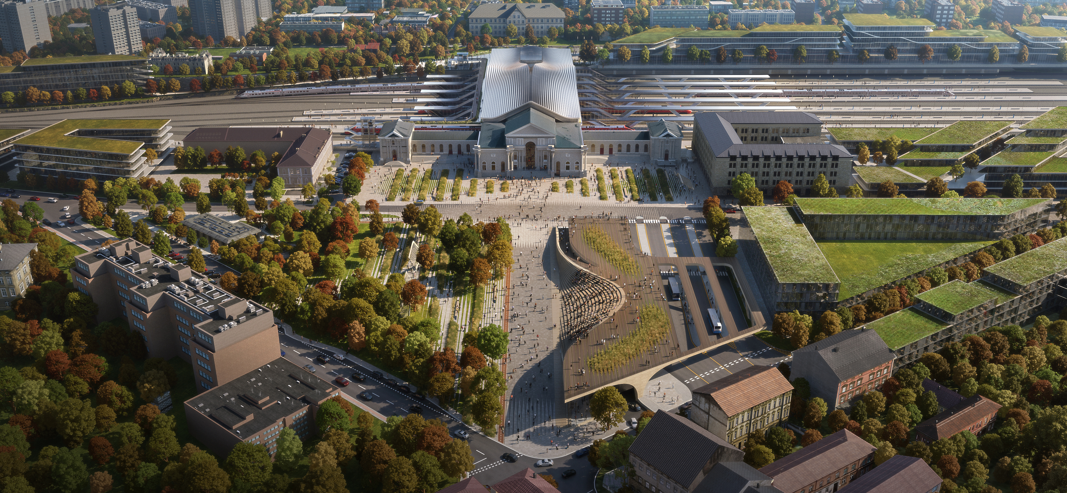
Progress in Lithuania
Kaunas – Lithuanian/Latvian border:
  land acquisition fully completed
  value engineering completed and master design prepared for 45 km
  construction works started (access roads) and procurements for ~30 km construction in final stage
  contract for the constructions of Neris bridge signed; contructions underway;
International Passenger Stations:
  Vilnius Connect - the winner of the international architecture competintion is chosen
Panevėžys node
  special planning on-going
Jiesia – LT/PL border, Kaunas – Vilnius:
  preparation of special territorial planning documents on-going (conceptual alternatives solutions approved; specified solutions and environmental impact assessment under preparation)
Kaunas node
  preferred alternative chosen
Legal package to allow design and land acquisition in parallel in final stage.
Panevėžys
Kaunas
Vilnius

Slide 9
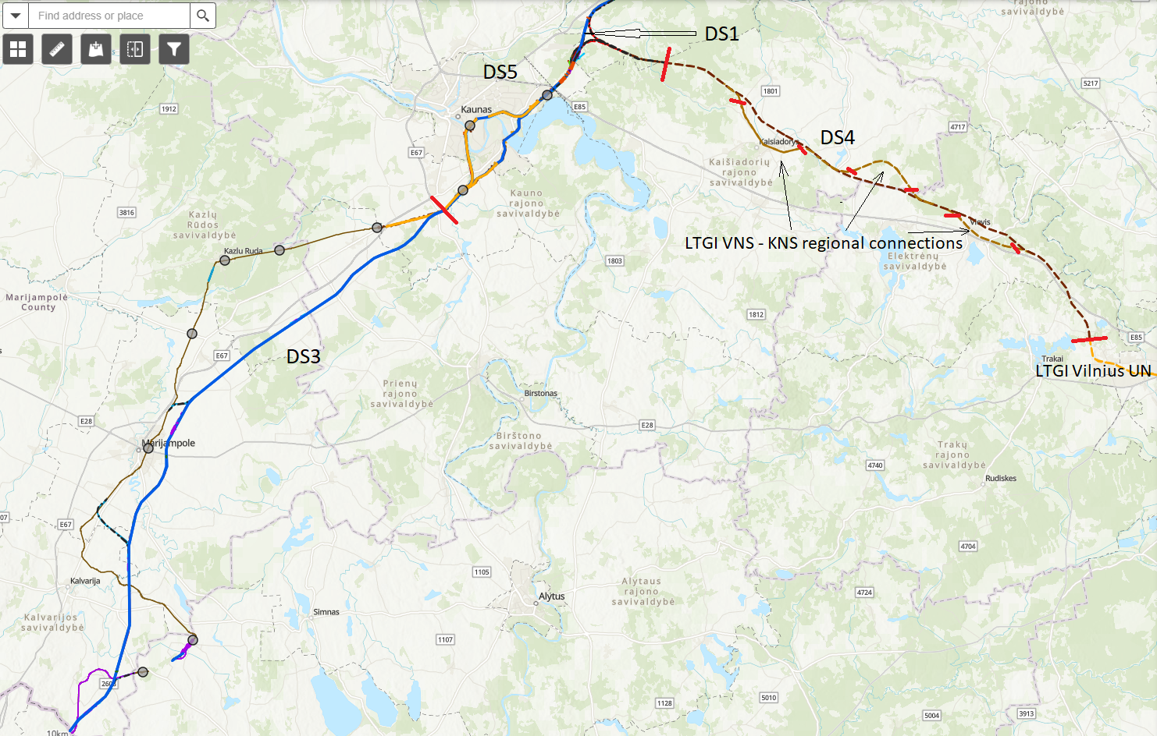
Kaunas Urban Node – Interface Management
DS1
Kaunas Urban Node (DS5) is located at a crucial intersection of other Rail Baltica projects in Lithuania. It has direct interface with other Design Sections:
DS1 – Palemonas - Panevėžys
DS3 - Jiesia - LT / PL border
DS4 - Vilnius UN - Kaunas UN
DS5 - Kaunas Urban node (Kaunas node + Kaunas triangle) also includes the design and design supervision services of railway infrastructure supporting facilities
DS5

Slide 10














General terms and the scope of building designs in Lithuania*
No. | Title | Description
1 | Services being procured | Master Design, Detailed Technical Design, Design Author’s supervision for the construction of the new railway line from through Kaunas Urban Node
2 | Contract period, deadline of the the new railway line from Vilnius Urban Node to Kaunas Urban Node | Master Design (24 months), Detailed Technical Design (72 months) and Design author’s supervision (96 month or until the full acceptance of construction works)
3 | Applicable procurement law | Latvian
4 | Contracting authority | RB Rail AS
5 | Contracting party | RB Rail AS
6 | Beneficiary | Ministry of Transport of the Republic of Lithuania
7 | Contract | Framework agreement
8 | Selection criteria during the Framework agreement implementation | Direct award with one winning tender
9 | Applicable construction law | Lithuanian

Slide 11
Contract
Kaunas Urban Node
Section 1 – Kaunas Triangle
Section 2 – Kaunas Node
Section 3 – Facilities
Land Melioration Project
Access Roads Projects
Various Reconstruction Projects
Railway Track (including all structures) Project
Access Roads Projects
Land Melioration Project
Various Reconstruction projects
Access Roads Projects
Land Melioration Project
Railway supporting infrastructure facilities
Special Structures
Railway Track (including all structures) Projects
Railway Track (including all structures) Project
Expected Work Breakdown Example
The overall contract is subdivided into smaller sections
Each section comprise number of Master Design (Technical Projects) to be completed
Payment is expected to be done when the activity in the entire section is completed
Master Design Services may include the following activities
Site Investigations
Design Proposals
Master Design
Acquisition or Building Permit

Slide 12
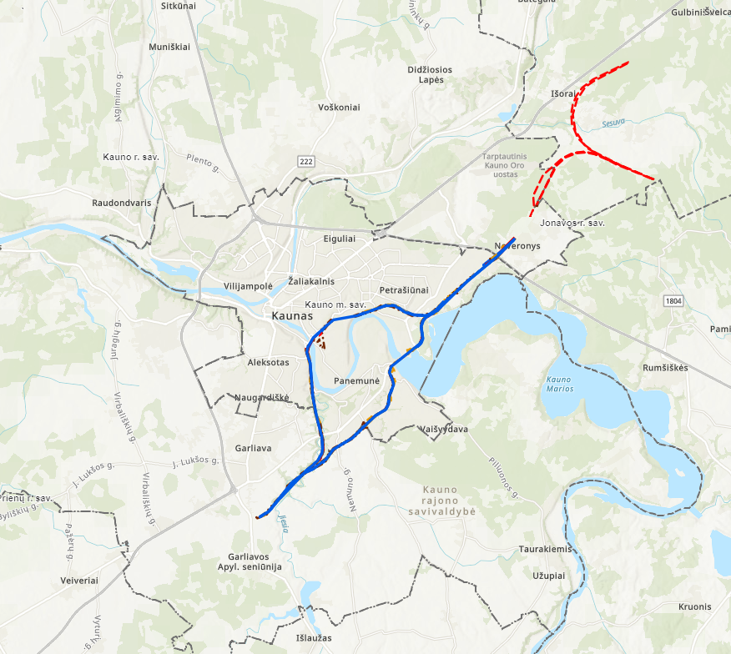
Kaunas Urban Node – Preliminary Scope
Note: All the design scope quantities are preliminary and detailed breakdown of the design scope will be provided during the second stage of this procurement.
Railway tracks:
1435mm gauge railway mainline double track
Kaunas Triangle + Airport Connection: approx. 25 km;
Palemonas–Jiesia through Kaunas Hydro Power Plant: approx. 16 km
Palemonas-Kaunas Station: approx. 9 km
Kaunas-Jiesia: approx. 11 km
1520mm gauge railway line single track reconstruction: where required
Station track networks, both 1435 and 1520 mm gauge at stations (approx. 20 km)
Structures:
Number of railway structures: bridges/viaducts: 14 (total ~7km)
Number of retaining wall structures (1.2m): ~3,6 km
Number of road structures bridges/viaducts/pergolas: 10 (total 420m)
Number of pedestrian structures: footbridges/subways/crossings: 550 m
Facilities: 1435 mm gauge railway supporting infrastructure facilities: 5 units (TBC);
Kaunas Triangle
Kaunas Node
(a)
(c)
(d)
(b)

Slide 13
Kaunas Urban Node – Preliminary Scope
(continued)
Other structures:
Number of passing loops: 0 (TBC);
Number of culverts: approx. 4 (TBC);
Number of green bridges: 0 (TBC);
Number of wildlife crossings: approx. 2 (TBC);
Other necessary infrastructure elements
Other infrastructure/utilities to be diverted/accommodated along the route:
Local Access Roads
Affected melioration (land reclamation) grid reconstruction;
Main oil and gas pipeline crossings/reconstructions;
High Voltage 110-330 kV power transmission line crossings;
Other utilities (fiber optics, telecoms, low/mid voltage electricity, other).
Kaunas Triangle
Kaunas Node

Slide 14
General information about planned procurements procedures
Preliminary procurements launch dates:
The First stage of the Competition – qualification stage for “Design and design supervision services for the construction of the new line through Kaunas Urban Node” – October 2022
The Second stage of the Competition – proposal stage and negotiations for “Design and design supervision services for the construction of the new line through Kaunas Urban Node” – beginning of 2023
The competition: competitive procedure with negotiation organized in accordance with the Public Procurement Law of Latvia
Planned contract signature for “Design and design supervision services for the construction of the new line from Vilnius Urban Node to Kaunas Urban Node” ~ July 2023
Notes:
The First stage of the Competition – qualification stage – selection of the qualified Candidates. During the selection of the Candidates the Procurement Commission shall select Candidates compliant with the requirements of the Regulations for participation in Second Stage of the Competition
The Second stage of the Competition – proposal stage - submission of initial proposal(s) of the qualified Candidates and negotiations, submission of final proposal(s) and awarding of Framework agreement. The regulations for the undertaking of possible negotiations, technical specification, contract draft, evaluation criteria will be provided in the Second Stage procurement documents.
Before the second stage of the procurement, we plan to meet with qualified tenderers to clarify the procedures for the second stage of the procurement

Slide 15
General information about planned procurements procedures
General minimum set of requirements for suppliers at the First stage of the procurements:
Legal standing and suitability for professional activity (enrolment in a professional registry);
Economic and financial standing (Financial turnover and liquidity);
Technical and professional ability (including key experts experience, preliminary key experts could be Design manager; 1435 mm gauge railway track designer; Structural/bridge designer) (possession of experience).
More information regarding Procurement Regulation and Supplier Qualification you can find at RB RAIL AS web page: https://www.railbaltica.org/procurement/procurement-regulation-supplier-qualification/
Please note, that Implementing Body is of importance to ensuring national security of Lithuania, and the Tender object relates to the national security interests of Lithuania. Thus, by abiding to the requirements of the Law on the Protection of Objects of Importance to Ensuring National Security of Lithuania, the Tender contract with Implementing Body may be concluded only if and when the Coordination Commission of the Protection of Objects of Importance to Ensuring National Security of Lithuania approves that the tenderer is compliant with the national security interests of Lithuania.
Notes:
Please note, when submitting documents supporting qualifications and experience, please make sure that the information provided is in line with the requirements, because after application deadline it is not allowed to add new projects to comply with company experience requirement (only clarification of provided information is possible).

Slide 16





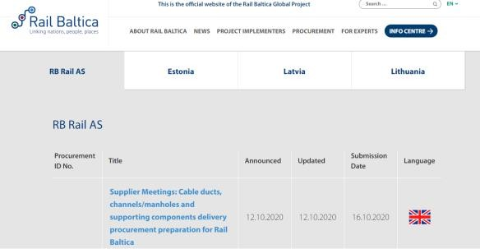





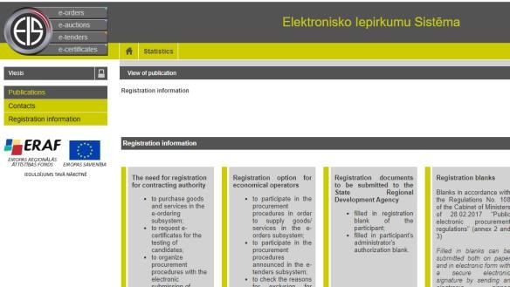







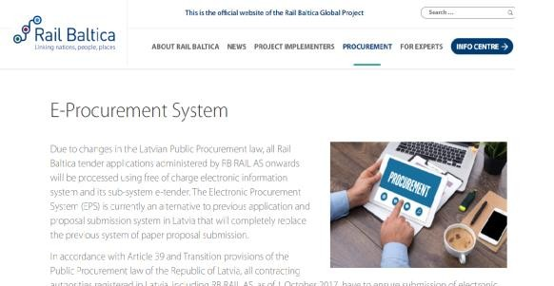





Notes:
Please do not leave your registration in the system for the last day, as it may take several days to confirm your registration.

Slide 17
Actions before the submission of application/proposal
SUBMISSION DEADLINE
Please read the requirements carefully and if something is not clear – provide questions. Supplier can ask questions and clarify requirements and also request to amend them. Please note it can only be done in advance to submission of the application/proposal!
No amendments after submission! Tenderer has accepted the requirements by submitting the application/proposal!
NB! Please read the Q&A letters published in RBR website before asking your question!
Notes:
If the supplier has any questions or comments regarding requirements of particular procurement, until the application/proposal submission deadline it has rights to ask questions, clarify any requirements and request (with justification) to amend the requirements.
NB! Please read the Q&A letters published in RBR website before asking your question as it may be that the same question has been asked by another supplier and has been already explained by the Commission.
After the submission of the application/proposal supplier is not allowed to request for any amendments in the procurement regulations, requirements etc. as it has accepted the requirements by submitting the proposal.

Slide 18
Information in the application/ proposal
Use the forms which have been provided in the procurement regulations (usually annexes regarding supplier experience, experts experience, financial standing etc.)
Annexes are prepared and structured in a way to assist the supplier in the preparation of all requested information and not to miss some information.
Consider the requirement included in the procurement regulations and describe the compliance at least in the same detail.

Slide 19
Partnership
There are no restrictions in any of RB Rail AS Procurements regarding the form in which supplier/-s can participate in the procurement.
However, in case supplier plans to participate in the procurement as partnership there are specific requirements, such as:
In the application/proposal a cooperation agreement/letter of intent must be submitted where it is agreed upon liability and responsibility of each member of the partnership and the signing persons must have right to represent the signing company.
Content of the partnership (members) cannot change during the procurement procedure. Choose the potential partners carefully to minimize the risk of future disagreements!
19
NB! Agreement must be signed by all members of partnership.

Slide 20
Representation rights/PoA
Commission must verify that the proposal and other respective documents have been signed by a person who has representation rights.
If the person/-s in the company registration certificate differs from the one signing the proposal, it is mandatory to submit the respective power of attorney or other document that verify the persons rights to represent the supplier and the rights of signature in the name of the company
In some cases the chain between the person indicated in the company registration certificate and the person who has signed the proposal consist of several documents.
NB! All chain of documents (PoA) must be provided to the Commission.
Notes:
Not applicable to contact person – it could be any person.

Slide 21
Exclusion ground documents I
Exclusion ground non-existance is a fact that must be verified by the Commission according to law.
Suppliers are kindly asked to read the Commissions request letter carefully as it is structured to assist the supplier in the preparation of all requested documentation.
NB! Please be aware that according to Public Procurement Law of Latvia supplier can have tax debts less than 150 EUR. If the tax debt will exceed 150 EUR, tenderer will be excluded from the procurement.
Notes:
Exclusion ground non-existance is a fact that must be verified by the Commission according to law, therefore no exceptions from the law can be applied.
Tax debts should be actual:
2stage procedure:
On the last day of the term for submitting Applications (in the First Stage) or on the day when a decision has been made on possible granting of rights to conclude the Contract (Second Stage of the Competition).

Slide 22
Exclusion ground documents II
Check the validity – if it is issued not more than 6 months before the submission of the specific document
Follow the decision of the governments as in some countries State authorities have prolonged validity of specific documents until the end of exceptional situation
Notes:
Validity
Is valid if it is issued not more than 6 months before the submission of the document (example, if the document have been issued on 01.05.2020 it is valid for the submission until 31.10.2020).
COVID-19 affects
Suppliers are kindly asked to follow the decision of the governments as in some countries State authorities have prolonged validity of specific documents (for example, tax payment related documents) until the end of exceptional situation.
NB! If in accordance with the laws of the country of registration of the supplier a person may not be a member of the management/supervisory board, legal representative, procure holder if a person is a subject to the grounds for exclusion, supplier is entitled to provide a relevant explanation (with reference and quote of the specific clause of the law of the country) instead of the statement.

Slide 23
Entities on which capabilites supplier is relying
These are entities which experience, financial status etc. supplier is relying upon to comply with qualification requirements.
There must be signed agreement or other document between the supplier and the Entity indicating that the resource on which it is relying will be available during the contract and how it will be provided. Declaration on provision of the resources only is not a sufficient proof!
Entity and subcontractor is not the same, but a third party can be Entity and subcontractor at the same time.
All Entities on which capabilities supplier is relying must be clearly indicated in the annex attached to the procurement regulations.
NB! Employees of the tenderer are not Entities or subcontractors.
Notes:
Commission must verify that such agreement between the tenderer and the entity on which capabilities it is relying exists.
It must be done to be sure that it is not just a formal way how tenderer wants to comply with the qualification requirements. Commission must be sure that the resources (as per qualification requirement) will be available to the tenderer in case of winning the procurement.
Entities on whose capacity supplier relies (Entity), are entities which experience, financial status etc. supplier is relying upon to comply with qualification requirements. So it means any legal or natural person on which capabilities the tenderer is relying to comply with qualification requirements of the regulation.
For example, natural person which is proposed as an expert and is an employee of a tenderer is not an “entity”, but a natural person which is proposed as an expert and is a freelancer is an “entity”.
Difference between Entity and subcontractor – subcontractor is third party to whom part of the performance of the contract is assigned. In case when the tenderer rely on capabilities of a third party to comply with any qualification criteria and at the same time this third party also is assigned to perform a part of the contract, then this third party will be Entity and subcontractor at the same time.

Slide 24
Experience requirements
For the projects indicated as reference projects Client references shall be provided
Do not add a long list of the reference projects if only one or two of them cover ALL THE REQUIREMENTS to experience
Projects, implemented by subcontractors can also be used as reference projects
NB! Please provide precise information as possible according to ALL PARAMETERS (e.g. length of the track, TSI compliance, bridge/viaduct length and span, BIM Level and project parameters, etc.)
set in Experience requirements!
Notes:
Commission must verify that such agreement between the tenderer and the entity on which capabilities it is relying exists.
It must be done to be sure that it is not just a formal way how tenderer wants to comply with the qualification requirements. Commission must be sure that the resources (as per qualification requirement) will be available to the tenderer in case of winning the procurement.
Entities on whose capacity supplier relies (Entity), are entities which experience, financial status etc. supplier is relying upon to comply with qualification requirements. So it means any legal or natural person on which capabilities the tenderer is relying to comply with qualification requirements of the regulation.
For example, natural person which is proposed as an expert and is an employee of a tenderer is not an “entity”, but a natural person which is proposed as an expert and is a freelancer is an “entity”.
Difference between Entity and subcontractor – subcontractor is third party to whom part of the performance of the contract is assigned. In case when the tenderer rely on capabilities of a third party to comply with any qualification criteria and at the same time this third party also is assigned to perform a part of the contract, then this third party will be Entity and subcontractor at the same time.

Slide 25
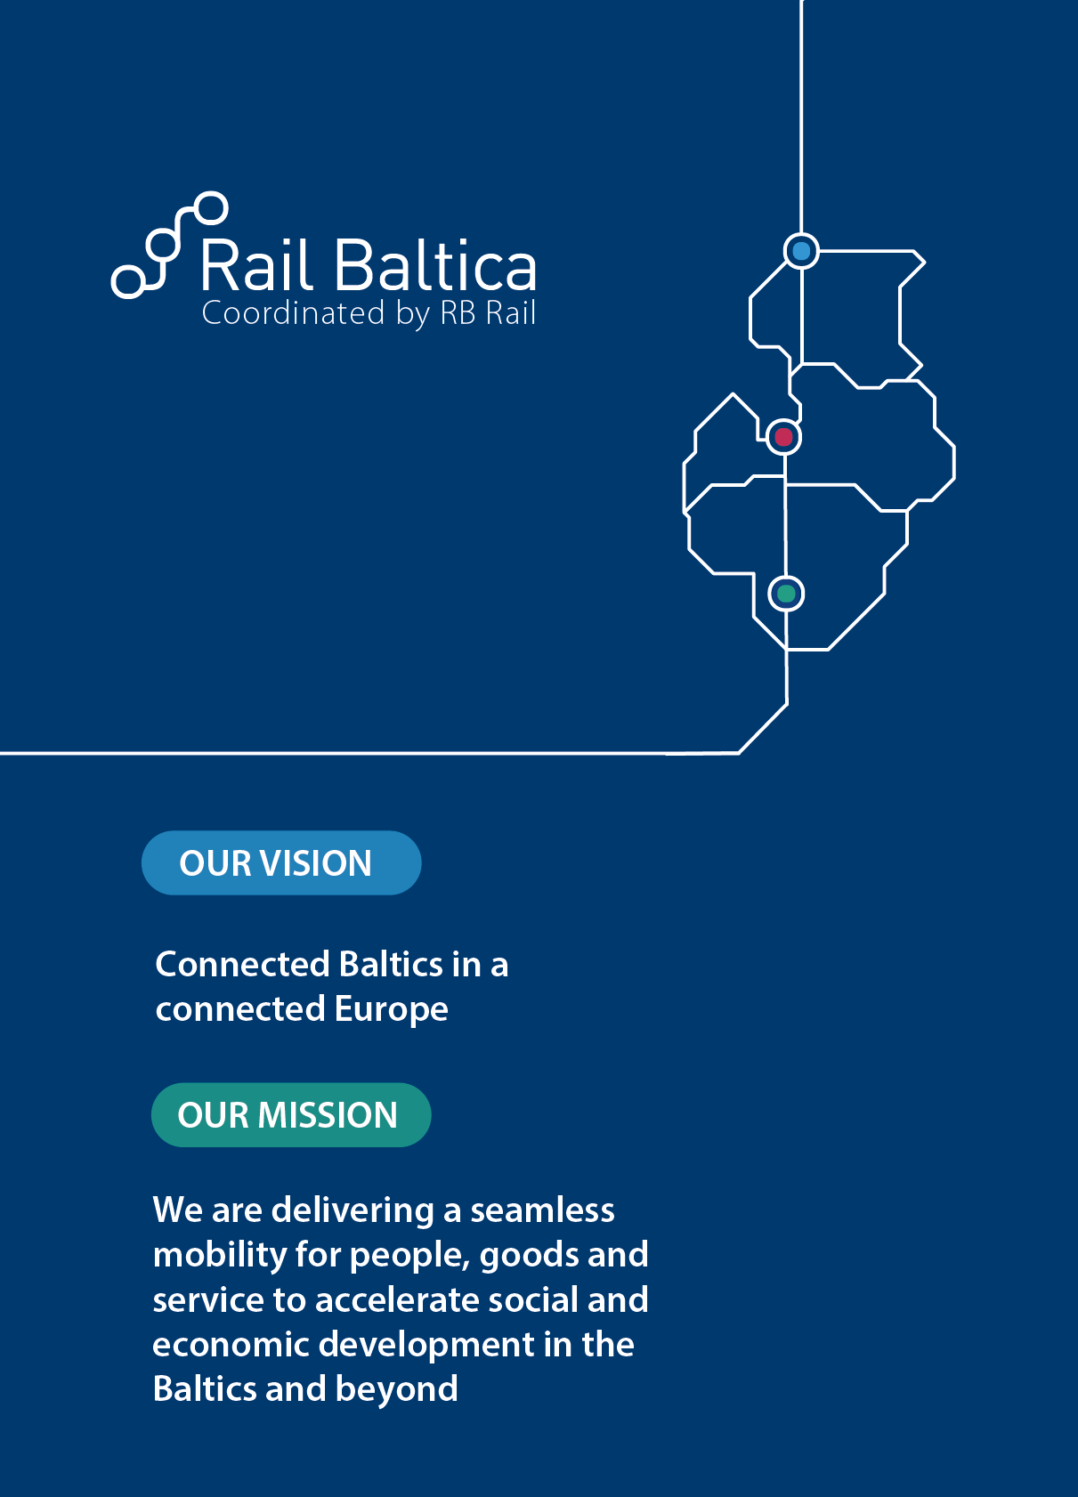



Thank you!
Time for Q&A session
www.railbaltica.org

