Slide 1
Briefing on the submission of the Application
Procurement of Consolidated supply of Fence components for Rail Baltica railway construction,
RBR 2022/21
Mārtiņš Blaus , Procurement Manager, RB Rail AS
Anastasija Luceviča Procurement Specialist, RB Rail AS
27.09.2022

Slide 2
Agenda
Information on the published Procurement exercise;
Registration in the E-Tenders system (available user manuals);
Introduction to the Qualification stage regulations;
Procurement Q&A process;
Submission of the Application;
FAQ;
Answers to the questions from the participants.

Slide 3
Description of the subject-matter
The subject-matter of the procurement is railway fence components – galvanized torsion mesh measured in m², regular, tension and bracing poles measured in m, tension wires and barbed wires measured in m, gates for the fence measured in pc and fencing accessories needed for the installation delivered to the material/construction site.
Subject matter is split into 3 lots, according to reagion of the delivery:
Railway fence components | Lot No 1 Lithuania | Lot No 2 Estonia | Lot No 3 Latvia
Galvanized torsion mesh: (5 x 5 cm) | 2 000 000 m² | 1 100 000 m² | 1 400 000 m²
Galvanized torsion mesh - (1 X 1 cm) | 300 000 m² | 160 000 m² | 200 000 m²
Regular + tension poles | 730 000 m | 390 000 m | 400 900 m
Bracing poles | 150 000 m | 80 000 m | 100 000 m
Tension wire (ᴓ 2,7 mm) | 1 700 000 m | 900 000 m | 1 160 000 m
Barb wire (ᴓ 1,7 mm) | 4 100 000 m | 2 200 000 m | 2 800 000 m
Portals | 1 700 pc | 950 pc | 1 100 pc
Safety gates | 900 pc | 500 pc | 600 pc
Railway fence installation components | Set | Set | Set

Slide 4
Procurement Legal Basis
01
02
Legislative Requirements
Company & Project Rules and Policies
Public Procurement Law of the Republic of Latvia
Cabinet Regulation No. 107 of the Republic of Latvia
Law on Prevention of Conflict of Interest in Activities of Public Officials
Law on Administrative Liability
Latest Latvian Court Practices
(EE and LT Court Practices)
EU Directives
European Court of Justice principles
Procurement Monitoring Bureau of the Republic of Latvia Practices
Contracting Scheme Agreement
Shareholders Agreement
Inter-Beneficiary Agreement
RB Rail AS Statutes
Common Procurement Standards and Guidelines
In-house Procurement Regulations:
  Regulations for Organisation of Procurements
Regulations on Representation Rights
Other in-house rules & policies
Procurement Commissions are safeguarded by Legislation, Corporate Governance and applicable practice, de-politicised and empowered to act based on due professional diligence, following the Rail Baltica Global Project requirements.

Slide 5
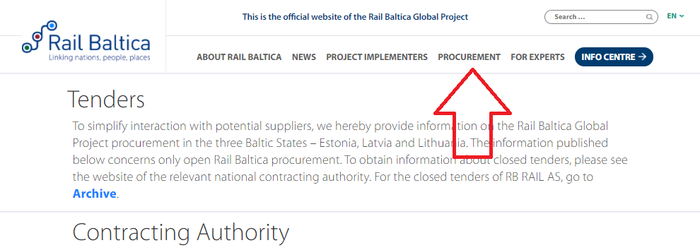
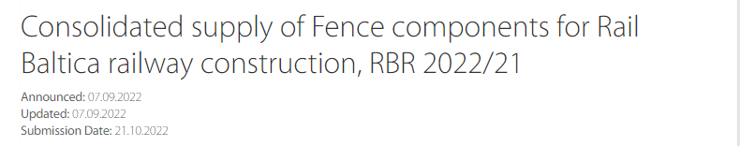
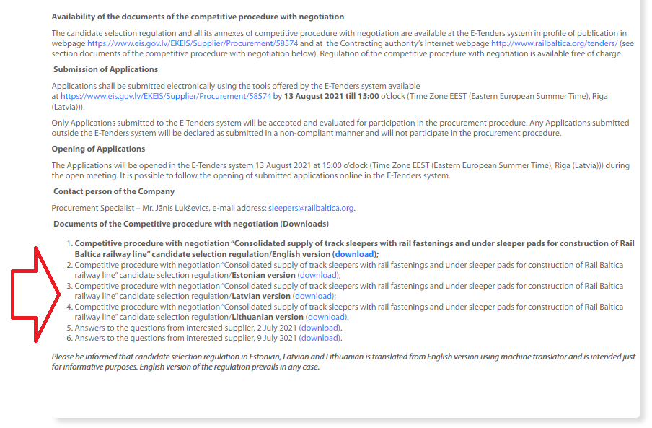
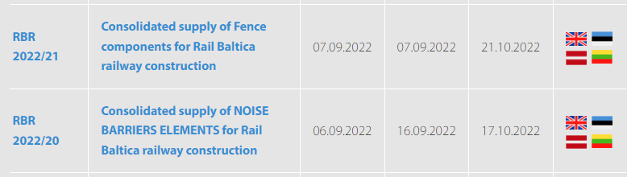
Where to find the information
www.railbaltica.org/tenders

Slide 6
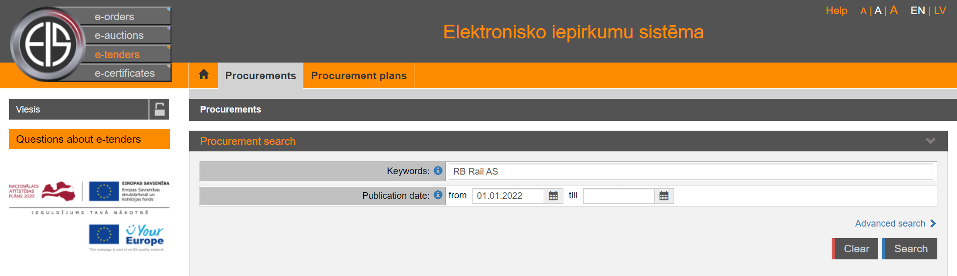
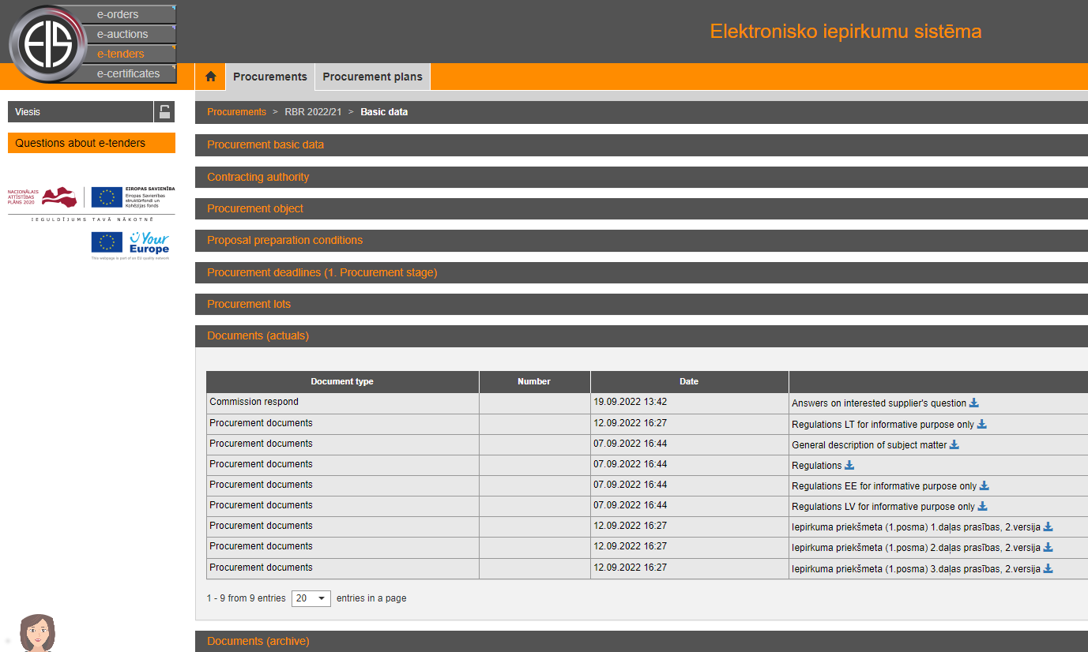
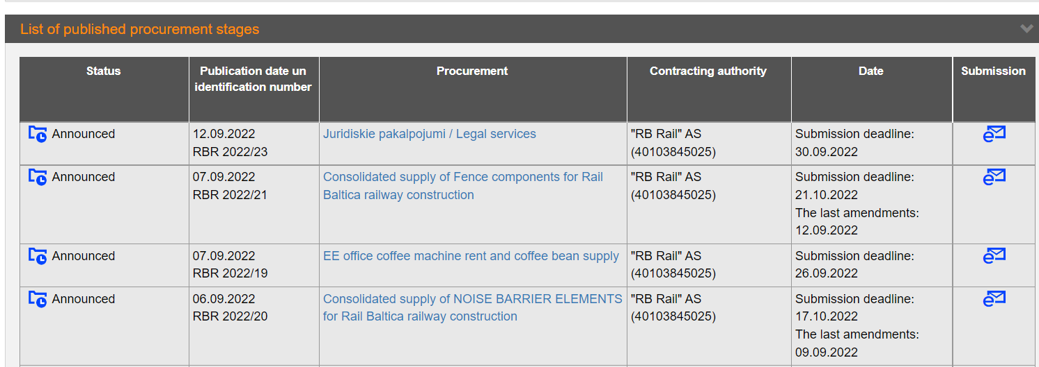



Where to find the information
https://www.eis.gov.lv/EKEIS/Supplier
$$←$$
$$→$$
$$→$$

Slide 7
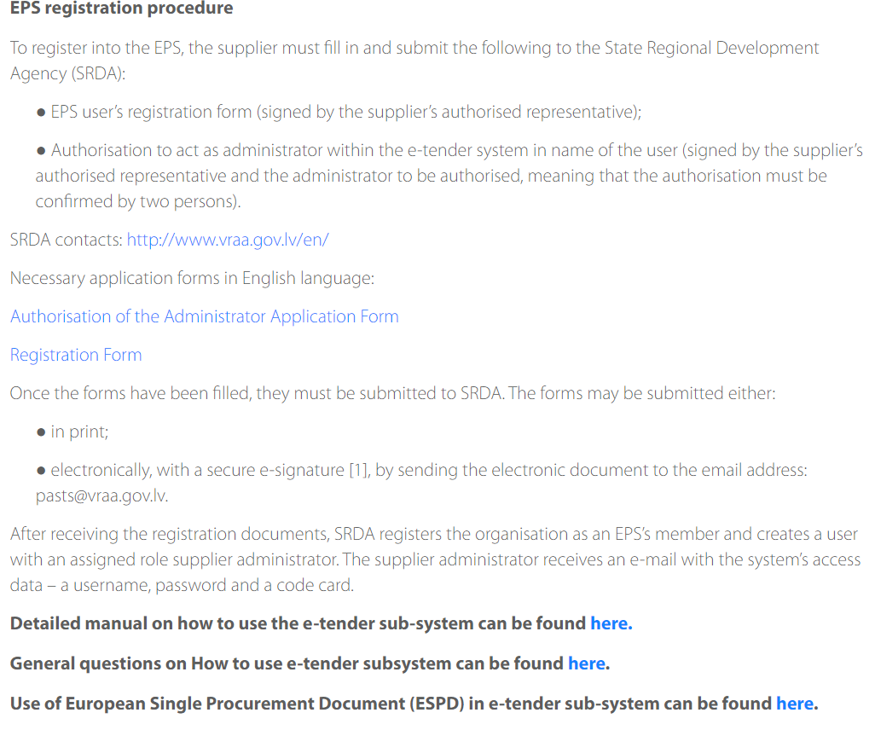
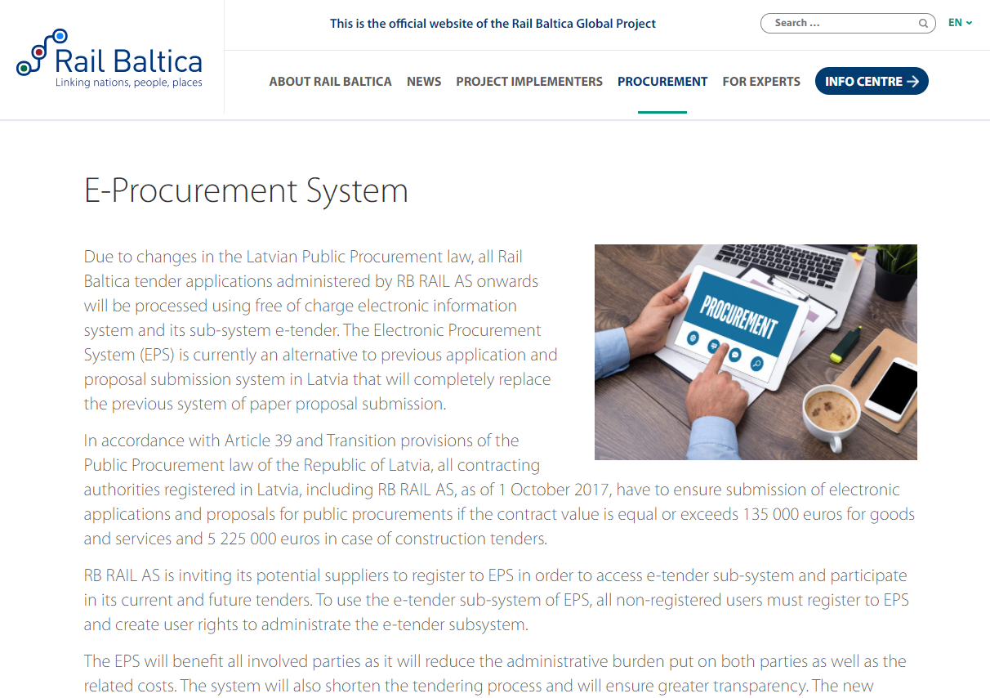
Registration in E-Tenders system

Slide 8
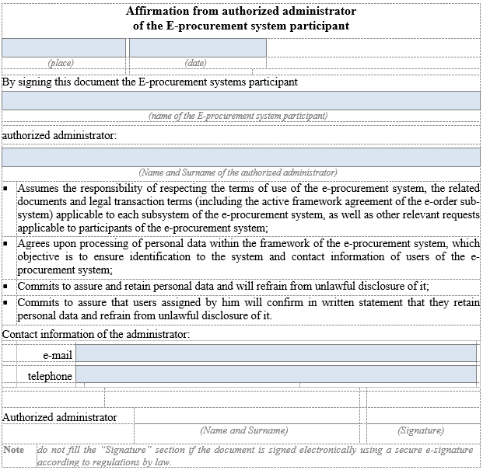
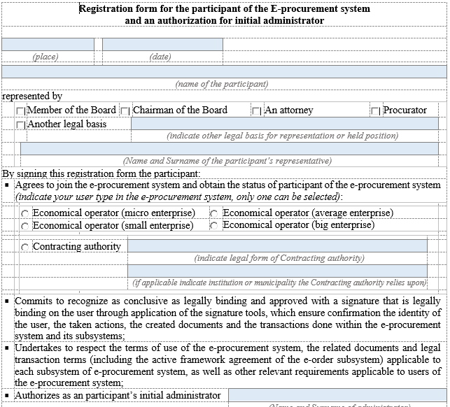
Registration in E-Tenders system
Two registration forms must be submitted to State Regeional developement agency
To Assign the administrator of the of the Profile
Registration of the Company in E-Tender system
Electronically signed and sent to email address: pasts@vraa.gov.lv

Slide 9
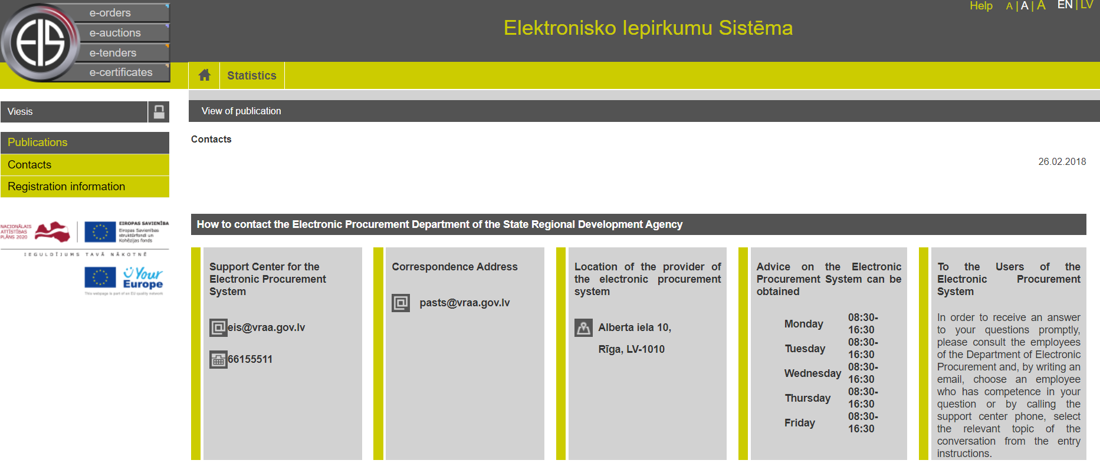
Registration in E-Tenders system
1) Please register as soone as possible;
2) Please specify in registration form e-mail address were incomming mails are checked regulary and check also spam folder before your registration is approved.
3) If you have any problems with registration or any other questions regarding EPS and E-Tenders subsystem, please contact:

Slide 10
Registration in E-Tenders system
If you have any problems with registration in EPS and E-Tenders subsystem, you may contact directly to:
Senior Consultant
Zigurds Drafens
zigurds.drafens@vraa.gov.lv
tel. +371 67509520
Advice on joining the e-Procurement system and updating user access data

Slide 11
Registration in E-Tenders system
Most frequent question regarding registration of group of suppliers:
Q: Which companies shall be registered as users of E-Tenders system in order to submit Application/ Proposal if the Candidate or tenderer is a group of suppliers?
A: If the candidate is a partnership (consisting of several companies which have made commitment to submit application or proposal jointly):
All members may register as users of E-Tenders system and submit application jointly;
Partnership may authorize one member to submit application/ proposal on behalf of the partnership (partnership agreement must be concluded and attached);
If the candidate is just relying on capabilities and capacity of other entities in order to meet any of qualification requirements or involve sub-contractors, these entities shall not be registered as users of E-Tenders system.

Slide 12
Introduction of the Qualification stage regulations
Regulation
1. General information
  Procurement Procedure: Competitive procedure with negotiation
  The Competition consists of two stages:
    Stage One (qualification) – selection of the Candidates.
    Stage Two (proposals) – submission of initial proposal(s) of the qualified Candidates and negotiations, submission of final proposal(s) and awarding of procurement contract.
    The subject-matter of the Competition – consolidated supply of Fence components for construction of Rail Baltica railway line.
    General description of the subject-matter of the Competition is included in Annex No 2 “General description of the subject matter” to the Regulation for the Selection of the Candidates. During the stage of the Selection of the Candidates, General description of the subject matter is given for informative purposes only.
    Detailed description of the subject-matter of procurement will be issued to the Candidates, which will be selected for participation in the Stage Two of the Competition.

Slide 13
Minimum set of requirements for suppliers
3
4
Enrolment in a professional registry
2
TECHNICAL & PROFESSIONAL
ABILITY
QUALITY STANDARDS
ECONOMIC &
FINANCIAL STANDING
Financial turnover
5
1
ENVIRONMENTAL STANDARDS
Professional experience
LEGAL STANDING &
SUITABILITY FOR
PROFESSIONAL
ACTIVITY
ISO 9001:2015 or equivalent
ISO 14001:2015 or equivalent
NB! If the Tenderer is a consortium, each member of the consortium shall comply with the above mentioned requirements

Slide 14
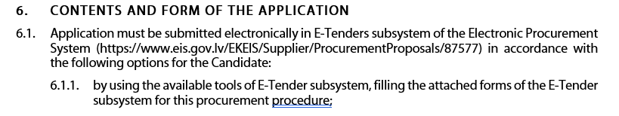
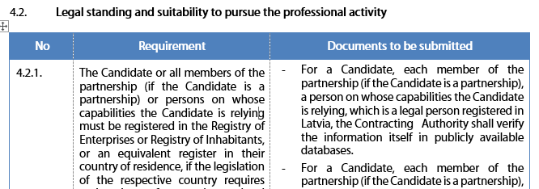
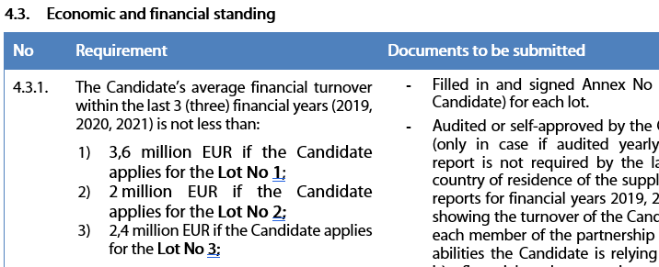
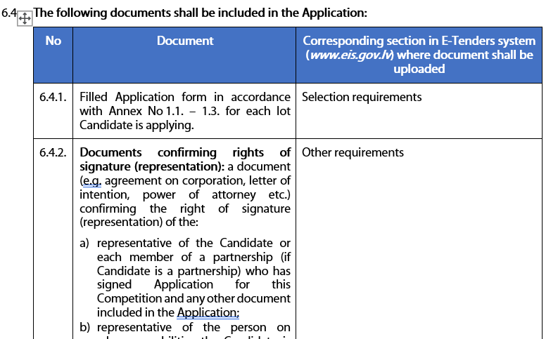
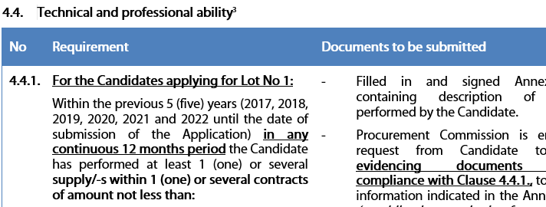
Introduction of the Qualification stage regulations
Regulation
2. information ABOUT the stage two of the Competition and the contract
4. Selection criteria for the CANDIDATES
4.1. Exclusion grounds (will be verified according to Section 10.2.3. of Regulation)

Slide 15
Information in the application/ proposal
Use the forms which have been provided in the procurement regulations (usually annexes regarding supplier experience, experts experience, financial standing etc.)
Annexes are prepared and structured in a way to assist the supplier in the preparation of all requested information and not to miss some information.
Consider the requirement included in the procurement regulations and describe the compliance at least in the same detail.

Slide 16
The Guidance
What we want to ensure?
  Better understanding of the public procurement principles, Rail Baltica project procurement process and requirements;
  Improvement of overall quality of the applications/proposals;
  Avoid mistakes in the application process which can lead to unnecessary rejection of the applications.
How to achieve this?
Carefully review the regulations (prepare the checklist of required documents)
Review all relevant Info on railbaltica.org and E-tendering system eis.gov.lv
If something is not clear - Submit the question timely

Slide 17
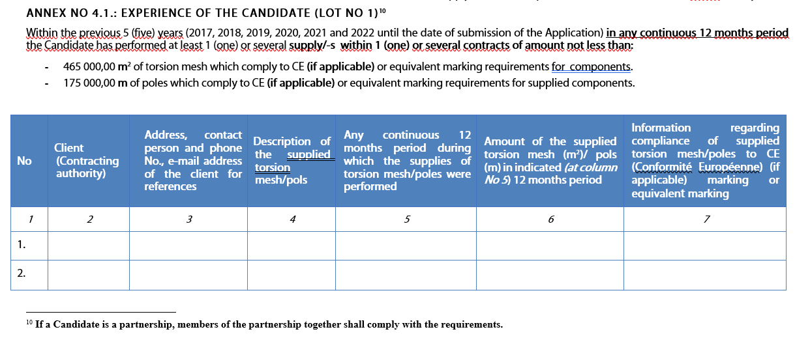
Example

Slide 18
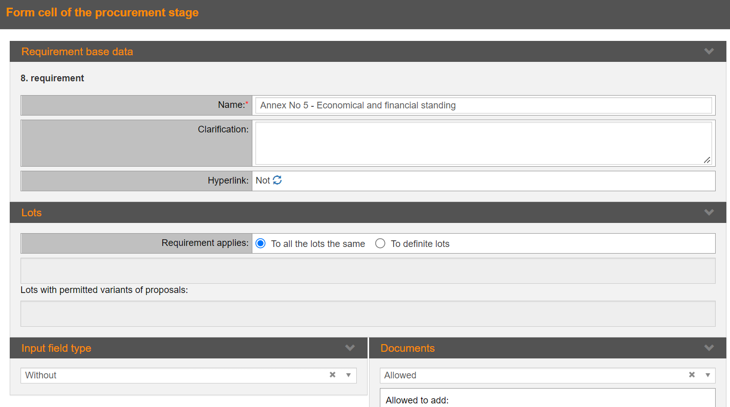
Forms to be filled in E-Tenders sytem

Slide 19
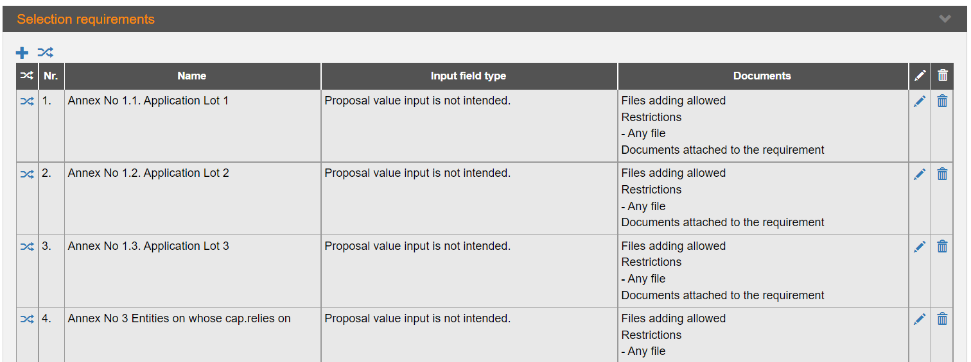
Forms to be filled in E-Tenders sytem

Slide 20
Actions before the submission
SUBMISSION DEADLINE
In Qualification stage questions may be asked:
1. By e-mail to: fence@railbaltica.org
2. In EIS system
(for registered users)
Supplier can ask questions and clarify requirements and request to amend them
No amendments after submission! Tenderer has accepted the requirements by submitting the proposal!
NB! Please read the Q&A letters published in RBR website before asking your question!

Slide 21
Qualification/evaluation
Qualification assessment is carried out according to YES/NO principle
Not allowed to add new projects to comply with company experience requirement
  Can supplier add new projects to comply with requirement during the clarifications?
Evaluation according to award criteria
NB! During the qualification assessment or evaluation Commission is not allowed to deviate from the qualification requirements or award criteria.

Slide 22
Clarifications/Amendments
Commission is willing to clarify all unclear information in the proposal before it makes the decision regarding non-compliance, however…
Commission must ensure:
  Transparency
  Free competition
  Equal and fair treatment
  Effective use of the funds of RB
Dos and Dont’s:
  It is allowed to clarify information which is included in the proposal (clarifications)
  It is not allowed to add totally new information to the proposal (amendments)
NB! Commission cannot recognize as compliant agreements, documents etc. which are dated after the proposal submission deadline, except the exclusion ground documents.

Slide 23
Partnership
There are no restrictions in any of RB Rail AS Procurements regarding the form in which supplier/-s can participate in the procurement.
However, in case supplier plans to participate in the procurement as partnership there are specific requirements, such as:
In the proposal a cooperation agreement must be submitted where it is agreed upon liability and responsibility of each member of the partnership.
Content of the partnership (members) cannot change during the procurement procedure. Choose the potential partners carefully to minimize the risk of future disagreements!
23
NB! Agreement must be signed by all members of partnership.

Slide 24
Entities on which capabilites supplier is relying
These are entities which experience, financial status etc. supplier is relying upon to comply with qualification requirements.
All Entities must be clearly indicated in the annex attached to the procurement regulations.
There must be signed agreement or other document between the supplier and the Entity indicating that the resource on which it is relying will be available during the contract.
Entity and subcontractor is not the same, but a third party can be Entity and subcontractor at the same time.
NB! Employees of the tenderer are not Entities or subcontractors.

Slide 25
Representation rights/PoA
Commission must verify that the proposal and other respective documents have been signed by a person who has representation rights.
If the person/-s in the company registration certificate differs from the one signing the proposal, it is mandatory to submit the respective power of attorney or other document that verify the persons rights to represent the supplier.
In some cases the chain between the person indicated in the company registration certificate and the person who has signed the proposal consist of several documents.
NB! All chain of documents (PoA) must be provided to the Commission.

Slide 26
Request for deadline extension
Must be justified
Must be sent in timely fashion
Reasons why commission usually reject the request:
  No justification
  Tight timeline of the procurement (which is related to overall RBGP timeline)
  Already reasonable time for submission has been provided
  Already reasonable extension has been provided

Slide 27
Thank you!
Time for Q&A session!

Slide 28
Useful Information
Deadline for the submission of the Applications: 21 October 2022, 14:00 (EET) in E-Tenders system
Please note: make sure you submit the Application timely (do not leave to the last day/minute),
Applications submitted earlier are not accessible or readable before the opening time!!!
  RBR website: https://www.railbaltica.org/tenders/
  RBR Procurement plan 2022: https://www.railbaltica.org/procurements/
  RBR procurements in E-tendering system: https://www.eis.gov.lv/EKEIS/Supplier/Organizer/3001
  Public Procurement Law of the Republic of Latvia: https://likumi.lv/ta/id/287760-publisko-iepirkumu-likums
  Cabinet Regulation No. 107 of the Republic of Latvia: https://likumi.lv/ta/id/289086-iepirkuma-proceduru-un-metu-konkursu-norises-kartiba
  Procurement Monitoring Bureau of Republic of Latvia website: https://www.iub.gov.lv/en
  Information system for certificates requested in procurement procedures across the EU: https://ec.europa.eu/tools/ecertis/#/homePage
  EU public procurement directive: https://eur-lex.europa.eu/legal-content/EN/TXT/?uri=celex%3A32014L0024
European Court of Justice judgements: https://curia.europa.eu/jcms/jcms/j_6/en/

