Slide 1
Design and design supervision services for the construction of the new line from Vilnius Urban Node to Kaunas Urban Node and
the new line from Lithuanian- Polish border to Kaunas Urban Node
MARKET CONSULTATION
February, 2022

Slide 2
Agenda
Introduction to the main rules of the meeting (10 min.)
General Introduction to the Rail Baltica Global project (10 min.)
General Information on the planned procurement “Design and design supervision services for the construction of the new line from Vilnius Urban Node to Kaunas Urban Node” Phase 1 (15 min.)
General Information on the planned procurement “Design and design supervision services for the construction of the new line from PL/LT border to Kaunas Urban Node” Phase 1 (15 min.)
Q&A session:
RB Rail AS questions to suppliers / suppliers answers (30 min.)
Suppliers questions / RB RAIL AS answers (30 min.)
Other (10 min.)

Slide 3
Rules and purpose of the meeting
Purpose of the consultation: To inform interested suppliers about the planned procurement exercise and the content of the subject-matter, as well as to obtain feedback from the interested suppliers regarding the main requirements.
Legal basis for the consultation: The consultation is organized in accordance with regulation of Section 18(2) of the Public Procurement Law of Latvia, which provides rights for the contracting authority to organize a consultation with suppliers in order to prepare for anticipated procurement procedure and inform potential suppliers about the procurement plan and requirements.
Time and place of the consultation: 15th February 2022 at 14:00 (Riga time), online, using the Microsoft Teams app.
The consultation will be recorded and a summarized version of the minutes will later be made available online at: www.railbaltica.org (a recording in Microsoft Teams will be retained, but not published or shared with the suppliers and/or third parties).
RAB RAIL AS shall not disclose any commercially sensitive information provided by suppliers during the meeting.

Slide 4
Rules and purpose of the meeting
Supplier’s confirmation:
By participating in this meeting the potential Supplier:
Confirms his/her participation in the meeting;
Confirms that the rules of the meeting are clear, and potential Supplier has no objection to the process of meeting.
At the potential Suppliers meeting, RB RAIL AS shall make no promises and/or commitments toward any business agreement or any proposal and shall not provide any acceptance of any offers or potential offers. The potential Suppliers meetings are intended to inform RB RAIL AS on the significant market related conditions. At this meeting, RB RAIL AS is not in a passion to discuss any other topics and shall not provide any information on any ongoing procurement procedures.

Slide 5
Rules and purpose of the meeting
Purpose of the consultation: To inform interested suppliers about the planned procurement exercise and the content of the subject-matter, as well as to obtain feedback from the interested suppliers regarding the main requirements.
Legal basis of the consultation: The consultation is organized in accordance with regulation of Section 18(2) of the Public Procurement Law of Republic of Latvia, with provides rights for the contracting authority to organize a consultation with suppliers in order to prepare for anticipated procurement procedure and inform potential suppliers about the procurement plan and requirements.
Time and place of the consultation: 11th February 2022 at 9:00 (Vilnius time), online, using Microsoft Teams app.
Meeting will be recorded for reference, transparency and audit purposes and summarized version of the minutes of meeting will later be made available online at: https://www.railbaltica.org. Sound/Video recordings of the e-meeting will not be shared with the suppliers and/or third parties.
RB RAIL AS shall not disclose any commercially sensitive information provided by suppliers during or after e-meeting.
Supplier’s confirmation:
By participating in this meeting the potential Supplier:
Confirms his/her participation in the e-meeting;
Confirms that the rules of meeting are clear, and potential Supplier has no objection to the process of meeting.
At the potential Suppliers meeting, RAB RAIL AS shall make no promises and/or commitments towards any busines agreement or any proposal and shall not provide any acceptance of any offers or potential offers. The potential Suppliers meeting are intended to inform RB RAIL AS on the significant market related conditions. At this meeting, RB RAIL AS is not in position to discuss any other topics and shall not provide any information on any ongoing procurement procedures.

Slide 8
Project implementation
progress in Lithuania
Kaunas node: Physical works in “Kaunas – Palemonas” essentially completed, ongoing acceptance procedures
Kaunas – LT/LV border:
Land expropriation completed
Value Engineering completed
Master design has started; 15 MD already approved out of ~88 total
First stage of main line construction procurement announced
Neris bridge procurement expected to be completed this month, National Security check to follow
Preparatory stage of special territorial planning for regional stations and ENE/CCS subsystems development started
Kaunas Urban Node, regional stations and IMFs spatial planning on going
LT/PL border – Kaunas Urban Node, Kaunas Urban Node – Vilnius Urban Node:
preparation of special territorial planning documents has started (the conceptual alternatives solutions alternatives are under analysis; strategic environmental assessment under preparation)
Challenges:
Covid 19 impact
Timely delivery of Master Designs enabling timely start of II stage of procurement for construction works with secured EU funding

Slide 9
General terms and the scope of building designs in Lithuania*
No. | Title | Description
1 | Services being procured (two separate procurements) | Master Design, Detailed Technical Design, Design Author’s supervision for the construction of: the new railway line from Vilnius Urban Node to Kaunas Urban Node; the new railway line from PL/LT border to Kaunas Urban Node.
2 | Contract period, deadline of the the new railway line from Vilnius Urban Node to Kaunas Urban Node | Master Design (24 months), Detailed Technical Design (72 months) and Design author’s supervision (96 month or until the full acceptance of construction works)
3 | Applicable procurement law | Latvian
4 | Contracting authority | RB Rail AS
5 | Contracting party | RB Rail AS
6 | Beneficiary | Ministry of Transport of the Republic of Lithuania
7 | Contract | Framework agreement
8 | Selection criteria during the Framework agreement implementation | Direct award with one winning tender
9 | Applicable construction law | Lithuanian

Slide 10
Contract (Vilnius – Kaunas) 64.35km
Section 1 – 22km
Section 2 – 18.35 km
Section 3 – 24 km
Railway Track (including all structures) Project
Land Melioration Project
Access Roads Projects
Various Reconstruction Projects
Railway Track (including all structures) Project
Access Roads Projects
Land Melioration Project
Various Reconstruction projects
Railway Track (including all structures) Projects
Access Roads Projects
Land Melioration Project
Various Reconstruction projects
Special Structures
Expected Work Breakdown Example
The overall contract is subdivided into smaller sections
Each section comprise number of Master Design (Technical Projects) to be completed
Payment is expected to be done when the activity in the entire section is completed
Master Design Services may include the following activities
Site Investigations
Design Proposals
Master Design
Acquisition or Building Permit

Slide 11
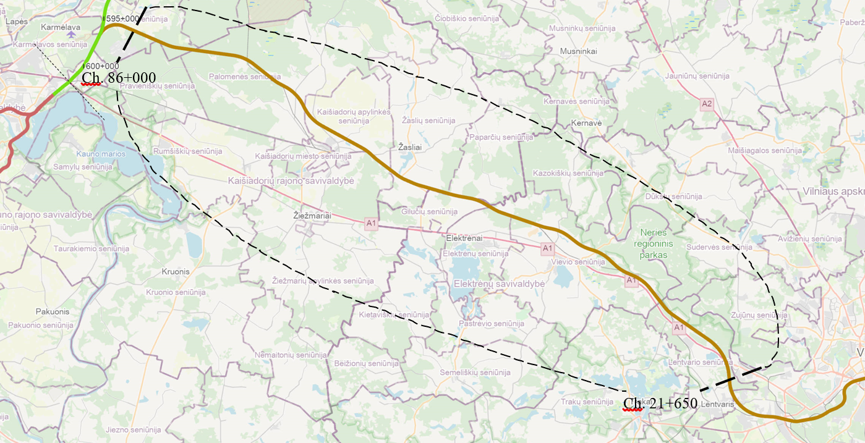
Kaunas Urban Node – Vilnius Urban Node Preliminary Scope
Key Railway Infrastructure
1435 mm gauge railway mainline double track: approx. 64.35 km;
1520 mm gauge existing railway reconstruction: approx. 11 km;
Number of passing loops: 3;
Number of road viaducts: 10;
Number of road tunnels: 1;
Number of railway viaducts: 13;
Number of railway pergolas: 3;
Number of wildlife crossings: 8;
Number of culverts: 15.
Other infrastructure/utilities to be diverted/accommodated along the route:
Affected melioration (land reclamation) grid reconstruction;
Main oil and gas pipeline crossings/reconstructions;
High Voltage 110-330 kV power transmission line crossings;
Other utilities (fibre optics, telecoms, low/mid voltage electricity, other).

Slide 12
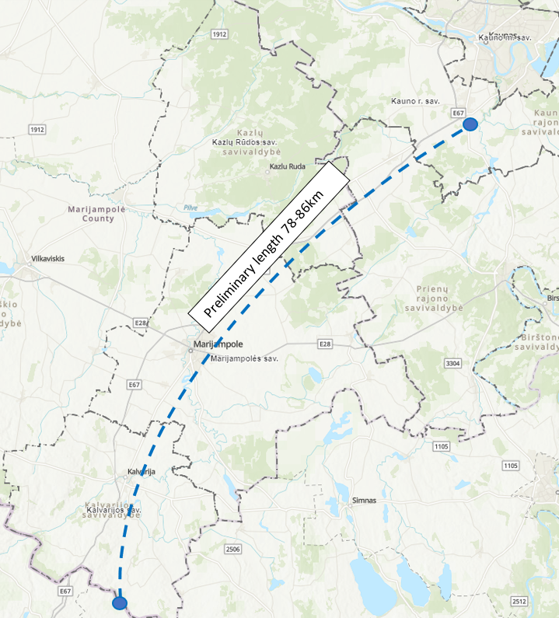
PL/LT Border – Kaunas Urban Node Preliminary Scope
Key Railway Infrastructure
1435 mm gauge railway mainline double track: approx. 78-85* km;
Number of passing loops: 2-3*;
Number of road structures bridges/viaducts/pergolas: 27-33*;
Number of railway structures: bridges/viaducts/pergolas: 18-26*;
Number of culverts: 46-58*.
Number of green bridges: 7-8*;
Number of wildlife crossings: 26-27**;
Reconstruction 1520 mm gauge existing railway
Other infrastructure/utilities to be diverted/accommodated along the route:
Affected melioration (land reclamation) grid reconstruction;
Main oil and gas pipeline crossings/reconstructions;
High Voltage 110-330 kV power transmission line crossings;
Other utilities (fibre optics, telecoms, low/mid voltage electricity, other).
* Optimal alternative not selected in Special Planning procedures yet, therefore numbers vary
**total number of wildlife crossings duplicates with culverts/green bridges

Slide 13
General information about planned procurements procedures
Preliminary procurements launch dates:
Design and design supervision services for the construction of the new line from Vilnius Urban Node to Kaunas Urban Node – February 2022
Design and design supervision services for the construction of the new line from PL/LT border to Kaunas Urban Node - II Quarter 2022.
The competition: competitive procedure with negotiation organized in accordance with the Public Procurement Law of Latvia
The competition consists of two stages:
The First stage of the Competition – qualification stage;
The Second stage of the Competition – proposal stage and negotiations.

Slide 14
General information about planned Contracting dates
Planned contract signature dates:
Design and design supervision services for the construction of the new line from Vilnius Urban Node to Kaunas Urban Node – IV Quarter of 2022
Design and design supervision services for the construction of the new line from PL/LT border to Kaunas Urban Node -IV Quarter of 2022- I Quarter of 2023

Slide 15
General information about planned procurements procedures
General minimum set of requirements for suppliers:
Legal standing and suitability for professional activity (enrolment in a professional registry);
Economic and financial standing (Financial turnover and liquidity);
Technical and professional ability (including key experts experience, preliminary key experts could be Design manager; 1435 mm gauge railway track designer; Structural/bridge designer) (possession of experience).
More information regarding Procurement Regulation and Supplier Qualification you can find at RB RAIL AS web page: https://www.railbaltica.org/procurement/procurement-regulation-supplier-qualification/
Please note, that Implementing Body is of importance to ensuring national security of Lithuania, and the Tender object relates to the national security interests of Lithuania. Thus, by abiding to the requirements of the Law on the Protection of Objects of Importance to Ensuring National Security of Lithuania, the Tender contract with Implementing Body may be concluded only if and when the Coordination Commission of the Protection of Objects of Importance to Ensuring National Security of Lithuania approves that the tenderer is compliant with the national security interests of Lithuania.

Slide 17
Thank you!
Time for Q&A session
www.railbaltica.org

