Slide 1
A Cross-Border Greenfield Megaproject: an opportunity for suppliers
Online meetings with suppliers, RB Rail AS, Rail Baltica Joint Venture
14-17 April 2020

Slide 2
Meeting agenda
Introduction to the Rail Baltica project; status update
Supplier presentations (products, experience/references, logistics, contractual issues, etc.)
Q&A session

Slide 3
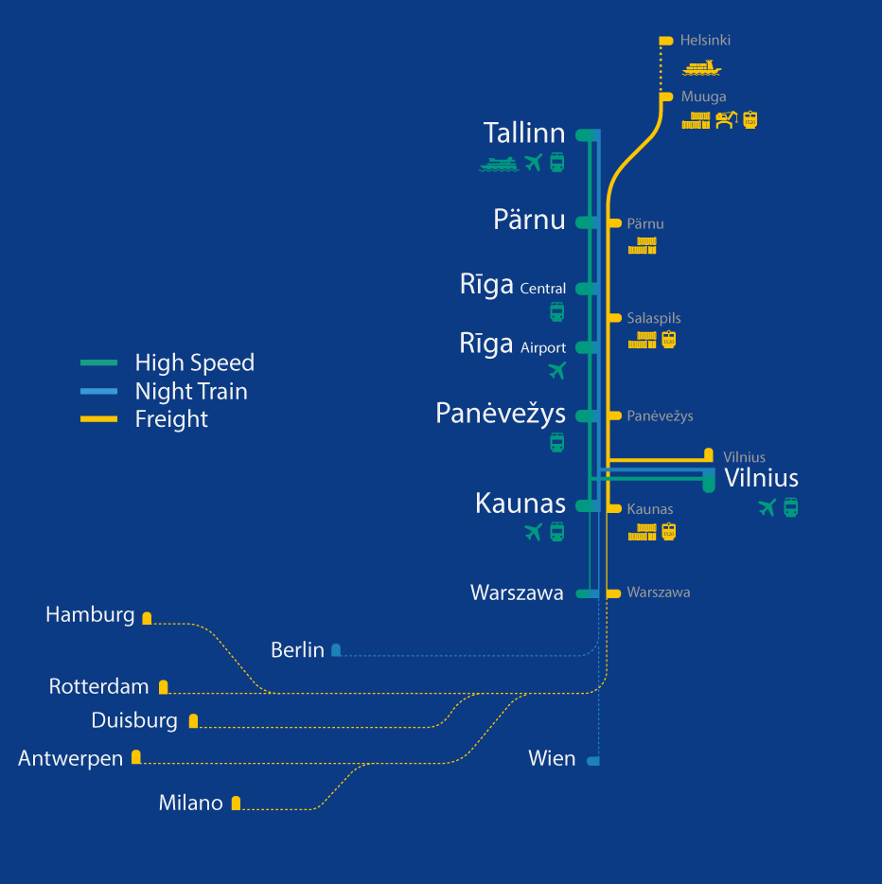
870 km greenfield railway infrastructure
0:40 min
1 h
1435 mm
Double track
0:08 min
ERTMS Level 2
0:45 min
Electrified
2x25kV AC
0:37 min
Maximum length of freight trains: 1050m
0:38 min
3:27 min
Axle load 25t
Design speed:
249 km/h for passenger trains
120 km/h for freight trains

Slide 4
Building a Truly International Rail Baltica
Involvement of international expertise
International, Pan-European and Baltic cooperation
Transfer of know-how

Slide 5
Notes:
Considerable efforts have been invested to create lasting partnerships with key railway actors in Europe:
European associations and agencies,
trade and investment agencies
Industry clusters
Ŗailway interest representation groups
AND national railway associations, including the French railway industry association FIF. With the help of the French embassy and in cooperation with the FIF a supplier seminar was organised in France in 2017 and a representative of FIF took part at the Rail Baltica Global Forum 2019 panel "Developing Business Partnerships with the Railway Industry in Europe - Rail Baltica experience, lessons learnt and next steps«.

Slide 6
Project Timeline by Phases
Planning
Design
Design
Civil Works construction
Railway Systems implementation
Commissioning
2019
2020
2021
2022
2023
2024
2025
2026
Notes:
* Moved into design phase
DTD contracts have been signed , technical designs are ongoing for the majority of the RB sections.
Construcion works to be commenced shortly (Riga Station end this year), prior to that land aquisiton for the whole line has to take place, least progess in particular in Latvia.
Potential delays in the schedule ?

Slide 7
Expectations from the online meetings
The key objective is to investigate various aspects of consolidated sourcing of rail components
RB Rail estimates on rail components needed:
Getting supplier feedback on:
Ballast ~ 3,9 million m3 (TBC)
Sleepers ~ 4+ million pieces (TBC)
Turnouts ~ 1260 pieces (TBC)
Rails ~ double track line
Other components…
Production capacities & capabilities
Optimal solutions for logistics
Preferred contractual aspects
Risks and risk mitigants
Other
Notes:
! Volumes shall be checked and agreed when experts will be available
Anete’s/Kaupo calculations?!

Slide 8
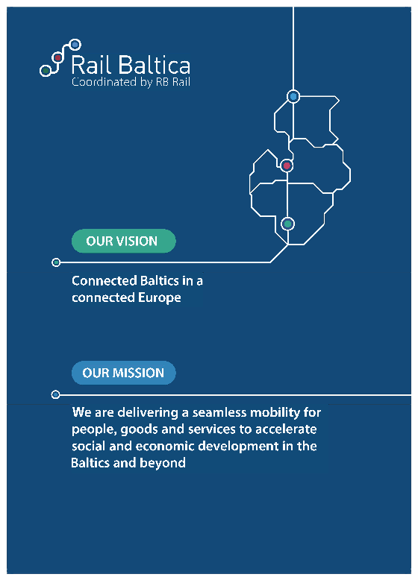
Thank you!
Rail Baltica Online Forum 2020 – Riga, 23 April.
info@railbaltica.org
www.railbaltica.org
K. Valdemara iela 8-7, Riga, Latvia
+ 371 66 967 171
linkedin.com/company/rb-rail

